Slide 1



HOW TO INTRODUCE
MEMBERSHIPS TO YOUR PATIENTS
RESOURCE GUIDE

Slide 2



TABLE OF CONTENTS
The Aesthetic consumer
How to talk about privi
When to
present privi
Marketing and resources
TIPS To
promote privi
Contact us

Slide 3


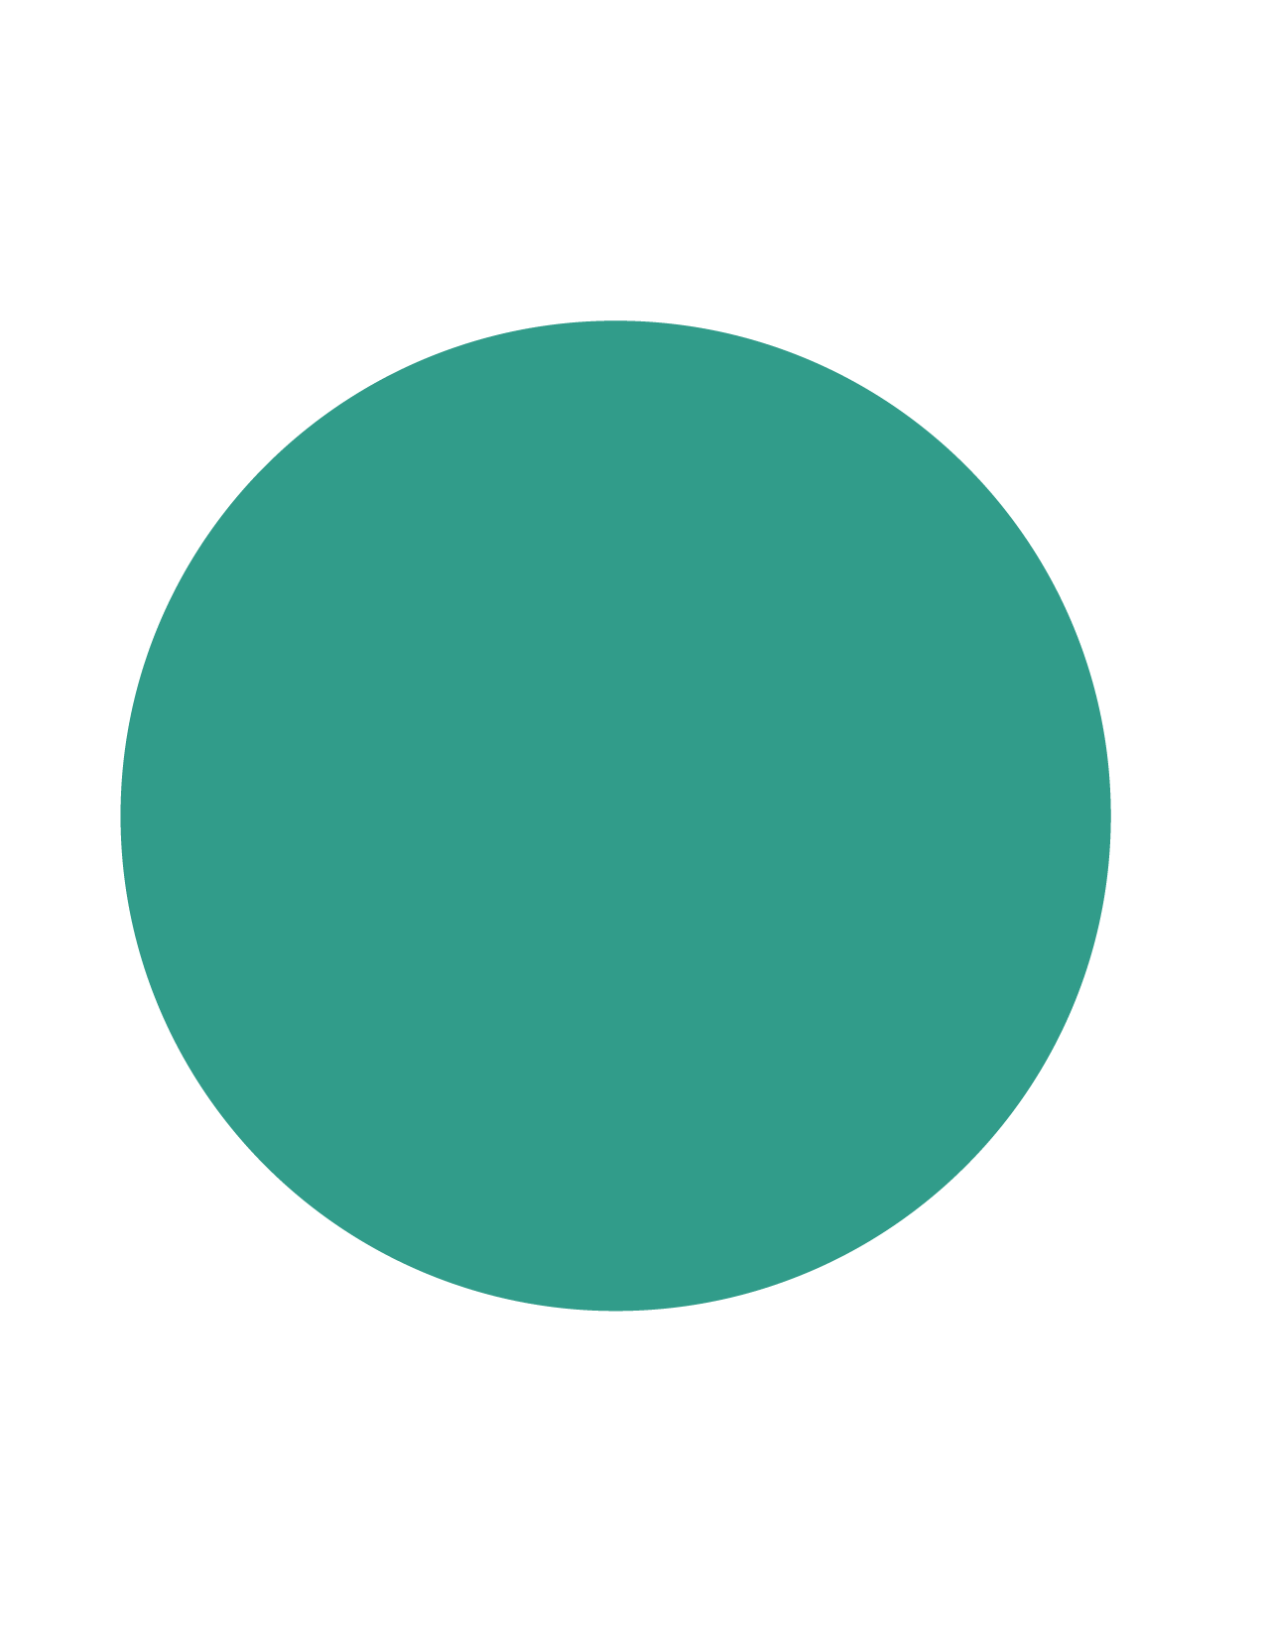

PATIENTS
WANT
Purchase intent increases when patients are offered a monthly membership vs. traditional payment¹
TO PAY ON A MEMBERSHIP
84%
of patients are
more likely to choose a provider that offers a monthly membership¹
TOXIN
FILLER
88%
MORE LIKELY
96%
MORE LIKELY
75%
of patients are interested in paying for aesthetic treatments on a monthly membership²
_{References}
1. PRIVI Data on file 2023 2. PatientFi Data on File 2023
*Survey of 350 US women considering aesthetic treatments

Slide 4
QUICK CONVERSATION GUIDE
TOP 3 THINGS YOU CAN TELL PATIENTS ABOUT PRIVI
1
2
3
BECOMING A MEMBER IS SIMPLE
Patients can sign up in seconds! PRIVI asks for just a few key details to set up their personalized PRIVI beauty membership.
KEEP YOUR BEST LOOK,
PAY MONTHLY
PRIVI is the best way for patients to achieve and maintain their best look all year on a convenient monthly membership they’ll love.
ACCESS EXCLUSIVE MEMBER PERKS
PRIVI members get treatments and other incentives at a special price–and auto-reminders when it’s time for to get treated again.
PATIENTS CAN MODIFY THEIR PRIVI PLAN AT ANY TIME

Slide 5

$189/mo
A better way
to present
The treatments patients want
Instead of presenting patients with one treatment cost, give them the results they really want all year at the convenient cost of a monthly membership.

Slide 6
KEY MOMENTS TO PRESENT PRIVI
HIGHLIGHT YOUR MEMBERSHIP THROUGHOUT
THE PATIENT JOURNEY
PRE-CONSULTATION
When patients call or email to ask about treatments and pricing, proactively share that you offer a convenient membership where patients pay monthly for annual treatment plans. Present any discounts or special offers to further incentivize the patient to sign up.
During Consultation
When discussing treatment options, don’t let price get in the way of optimal results. Let patients know that staying on track with a custom treatment plan is the best way to get and keep the look they want. Present the total cost and the cost of paying monthly. What sounds more affordable? Toxin for $450 or $99/mo?
At Check Out
Check-out is a great opportunity to remind patients they have options. Instead of asking “cash or card?” you can ask, “would you like to pay in full, or pay on our monthly membership?” Keep your custom PRIVI signage at the front desk to make sign-ups even easier.
Remember: patients are used to paying monthly for everything in their lives from the gym to their Netflix account. They expect and appreciate memberships that make it more convenient to pay for what they want. Don’t wait for the patient to ask.

Slide 7
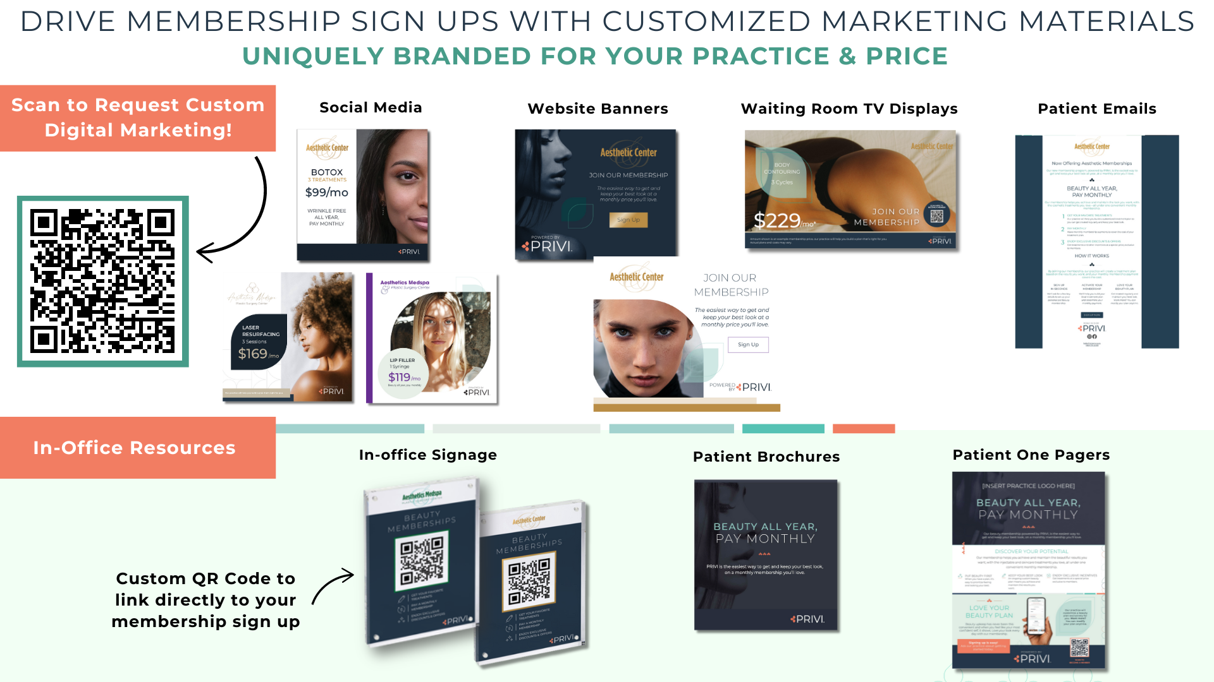
TOXIN

Slide 8
BEST PRACTICES
TOP 3 TIPS TO PROMOTE YOUR AESTHETIC MEMBERSHIP PROGRAM
1
USE SOCIAL MEDIA TO GET THE WORD OUT
Put your signup link in your practice’s Instagram bio and share frequently on your story.
2
UTILIZE YOUR QR CODE IN-OFFICE
Add your PRIVI QR code on signage around the office for easy signup during consultation or at checkout.
3
ADD A PRIVI BANNER TO YOUR WEBSITE
Place a PRIVI banner on your practice website and link it directly to your signup link.
Remember, PRIVI will create marketing for you. Click here to request assets.

Slide 9
QUESTIONS?
OUR TEAM IS HERE TO HELP.
privisuccess@patientfi.com
866.774.2409
CONTACT PRIVI TODAY
©PRIVI LLC. 2023. All Rights Reserved.

